Slide 1

ALY 6015 Intermediate Analytics Project- Motor Vehicle Collisions
By
Nithin Reddy.P: 002896440
Under the guidance of Dr. Harpreet Sharma

Slide 2

Introducing the dataset
The dataset comprises information on motor vehicle collisions in New York City, collected by the NYPD. It includes details such as crash date, time, borough, location, injuries, fatalities, contributing factors, and vehicle types.
It contains 2026647 observations with 29 variables

Slide 3
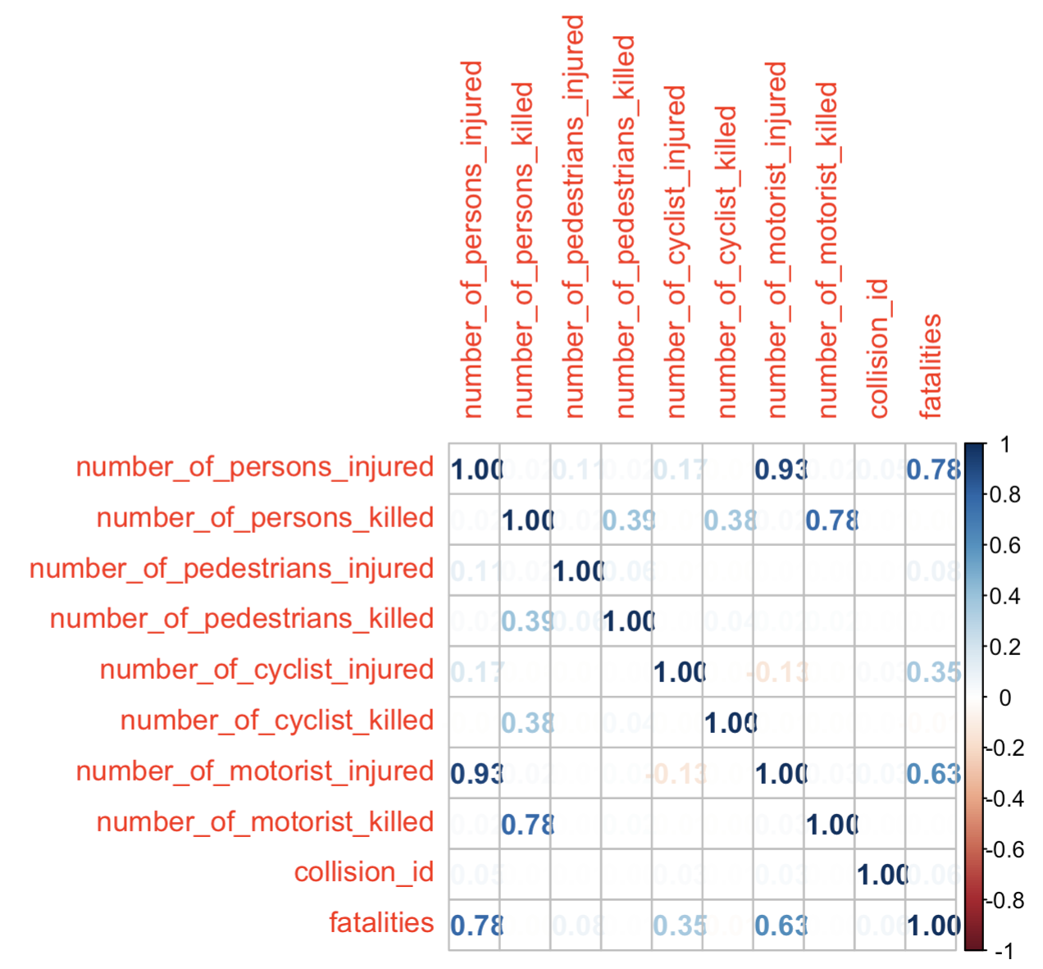
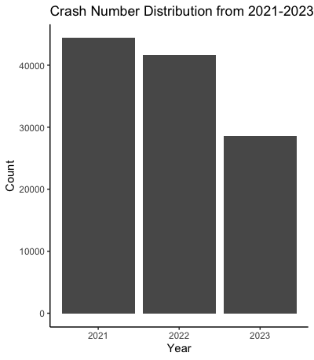
EDA

Slide 4
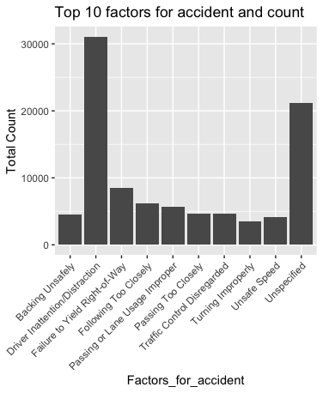
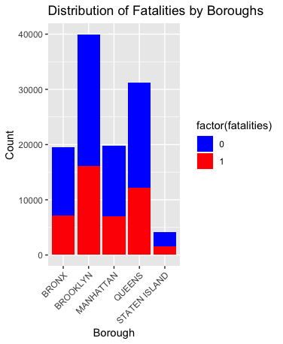
EDA

Slide 5
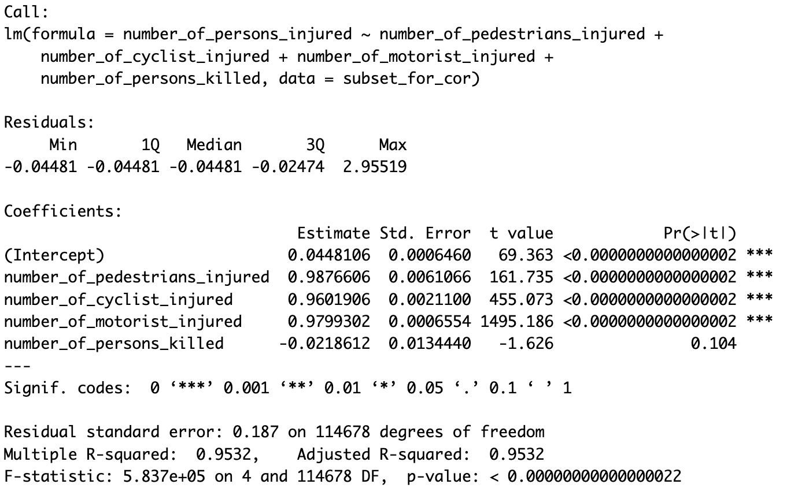
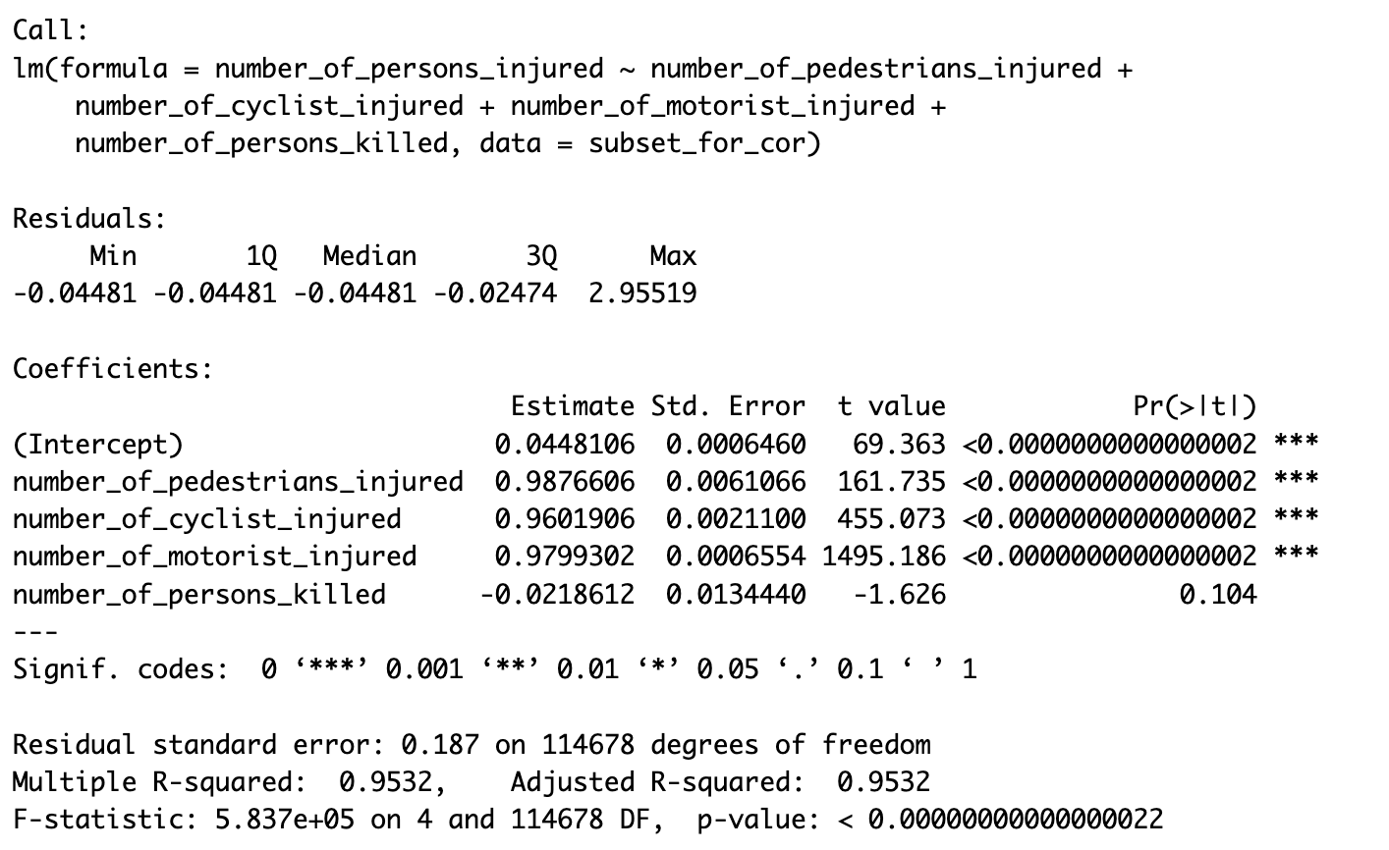
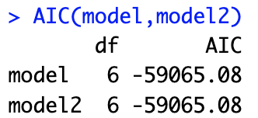
Multiple Regression
Model-1
Model Comparison
Model-2

Slide 6
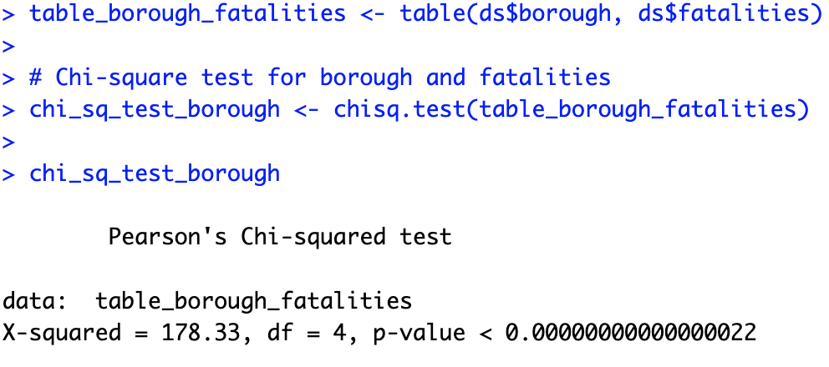
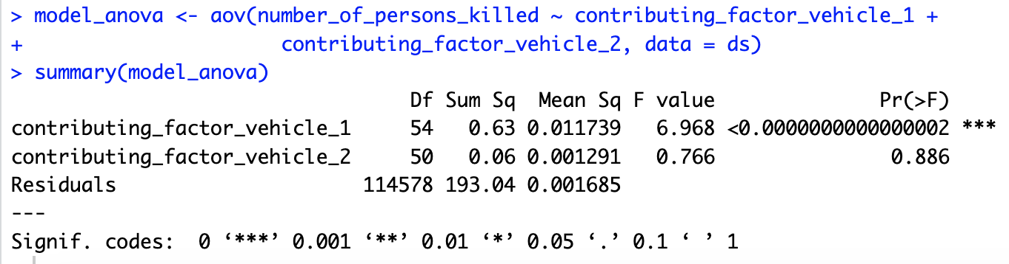
Anova and Chi-Square

Slide 7
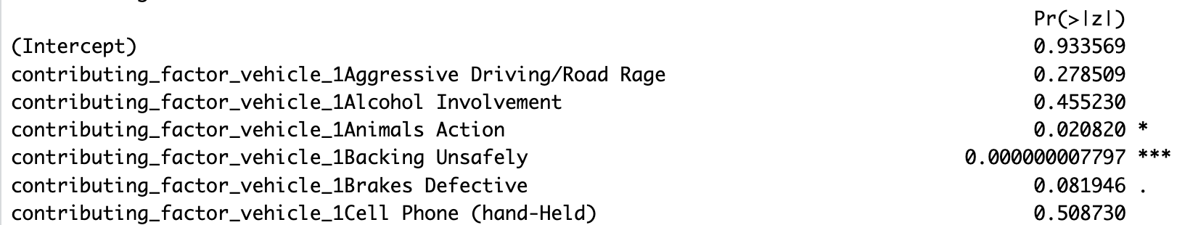
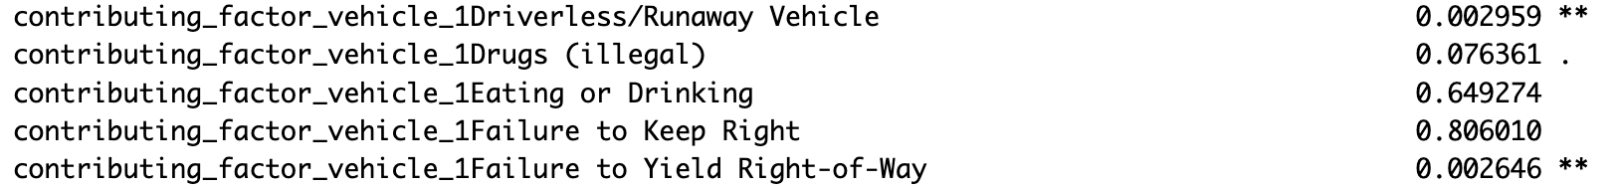
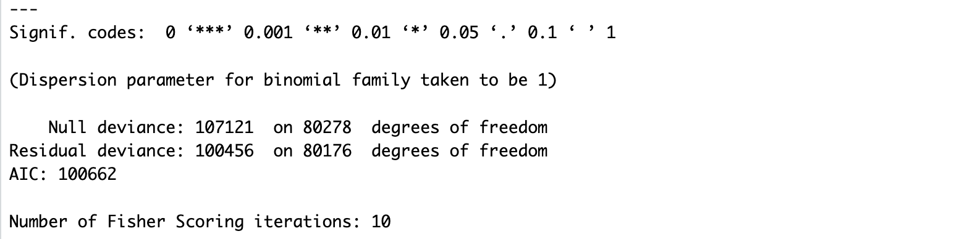
GLM and Logistic Regression

Slide 8
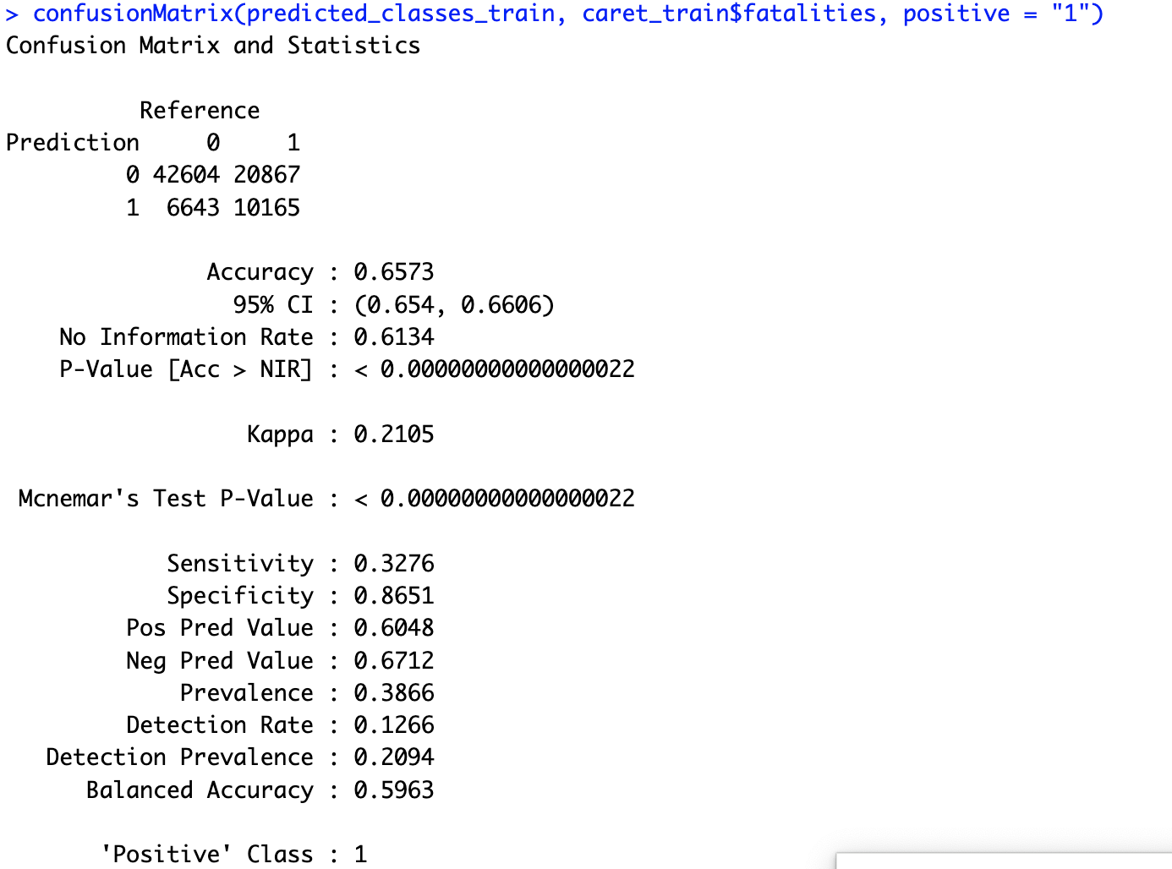
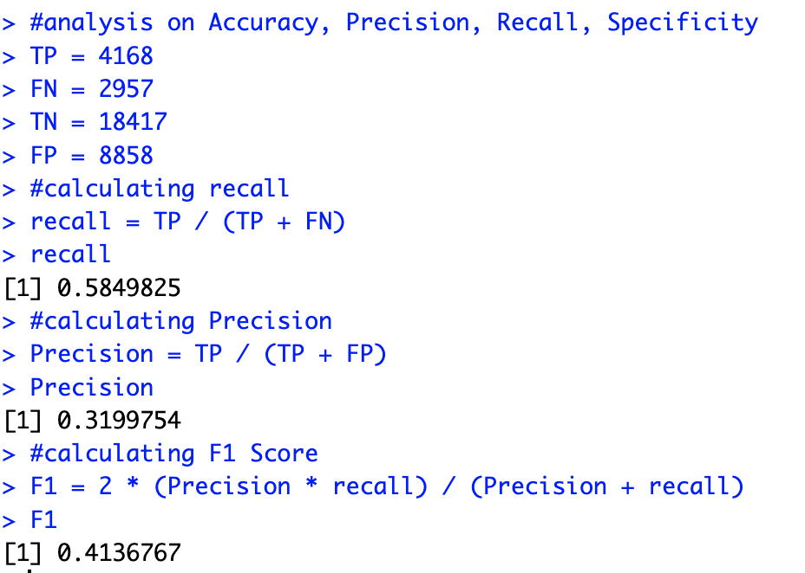
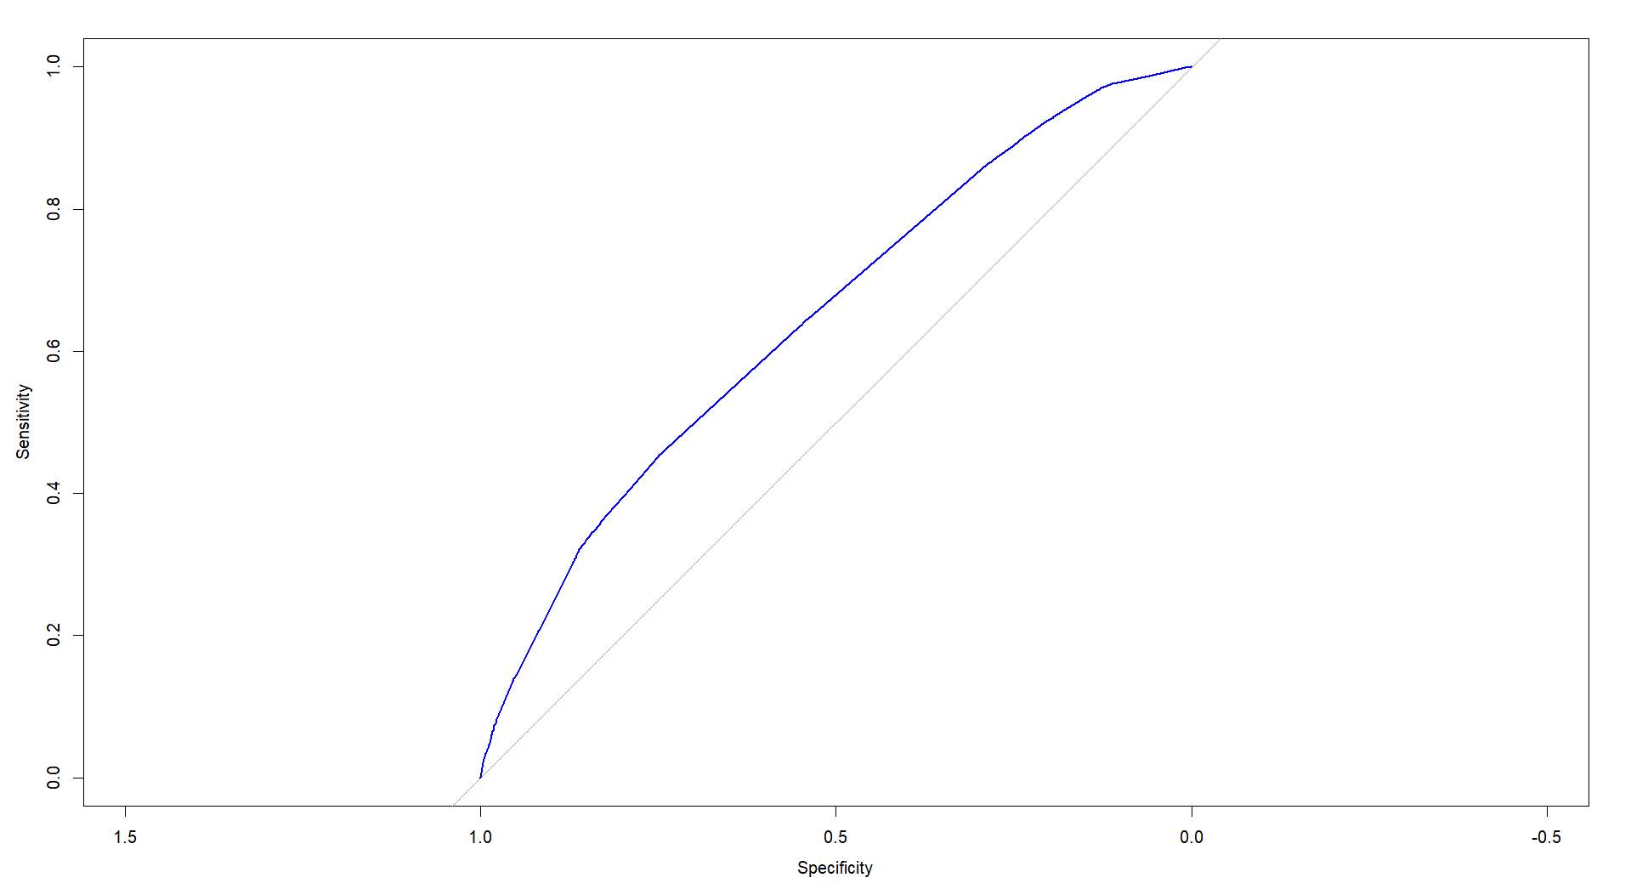

GLM and Logistic Regression

Slide 9
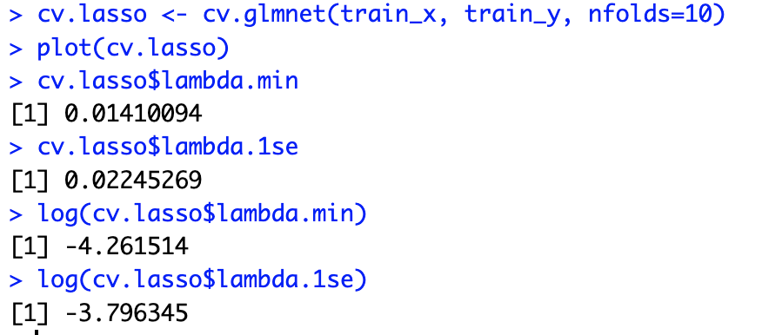
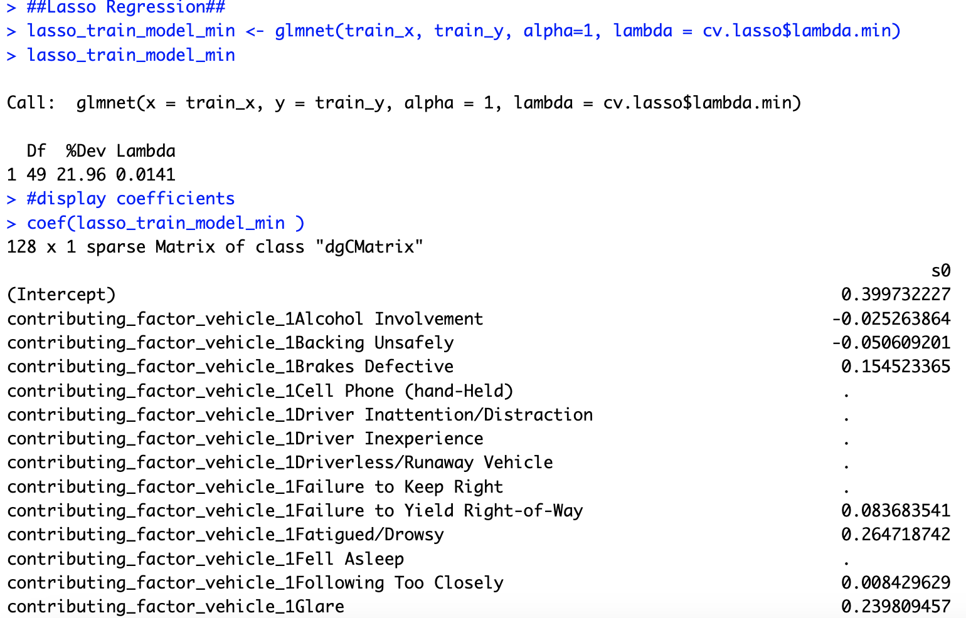
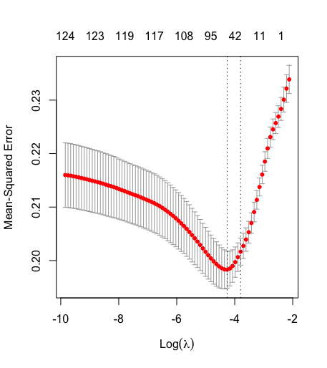
Regularization with Ridge/LASSO

Slide 10
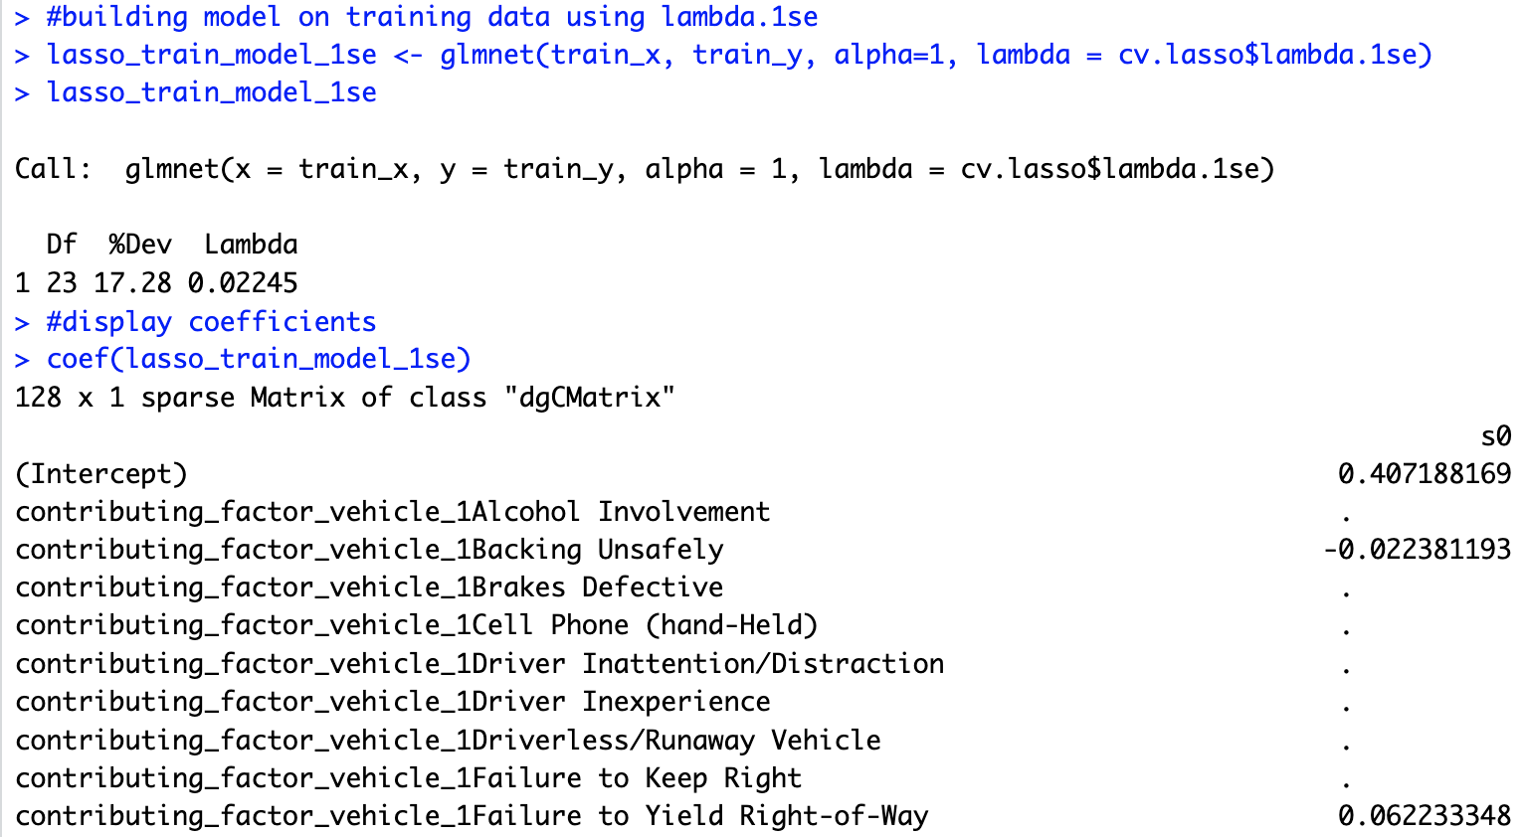
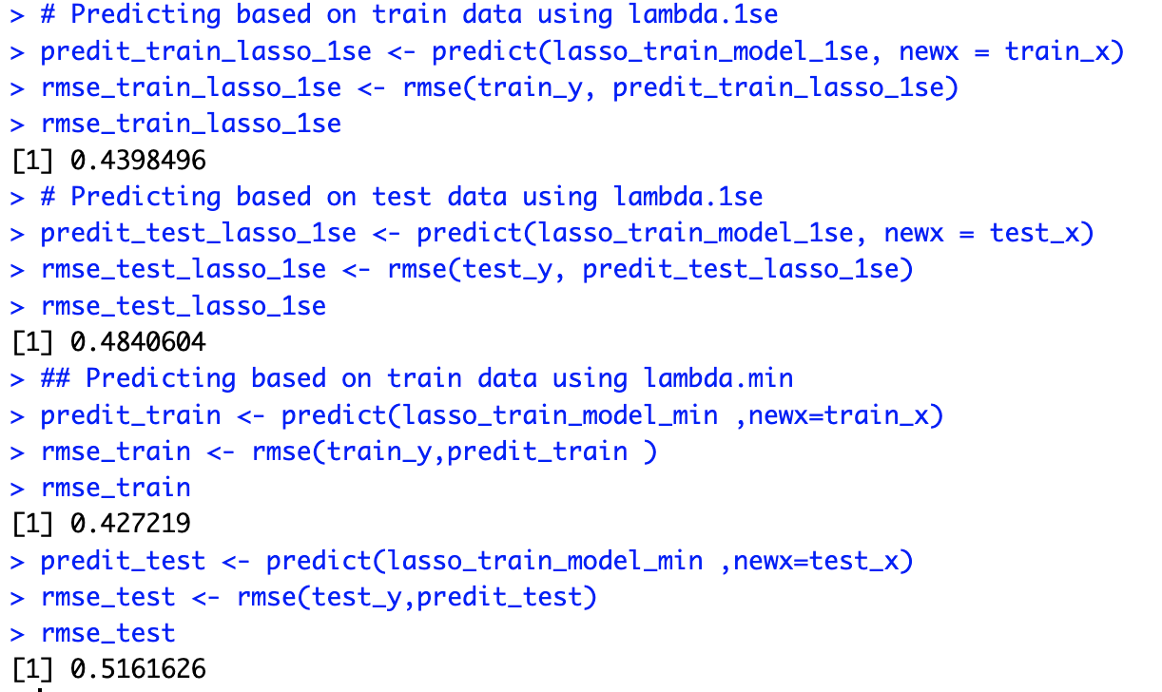
LASSO

Slide 11
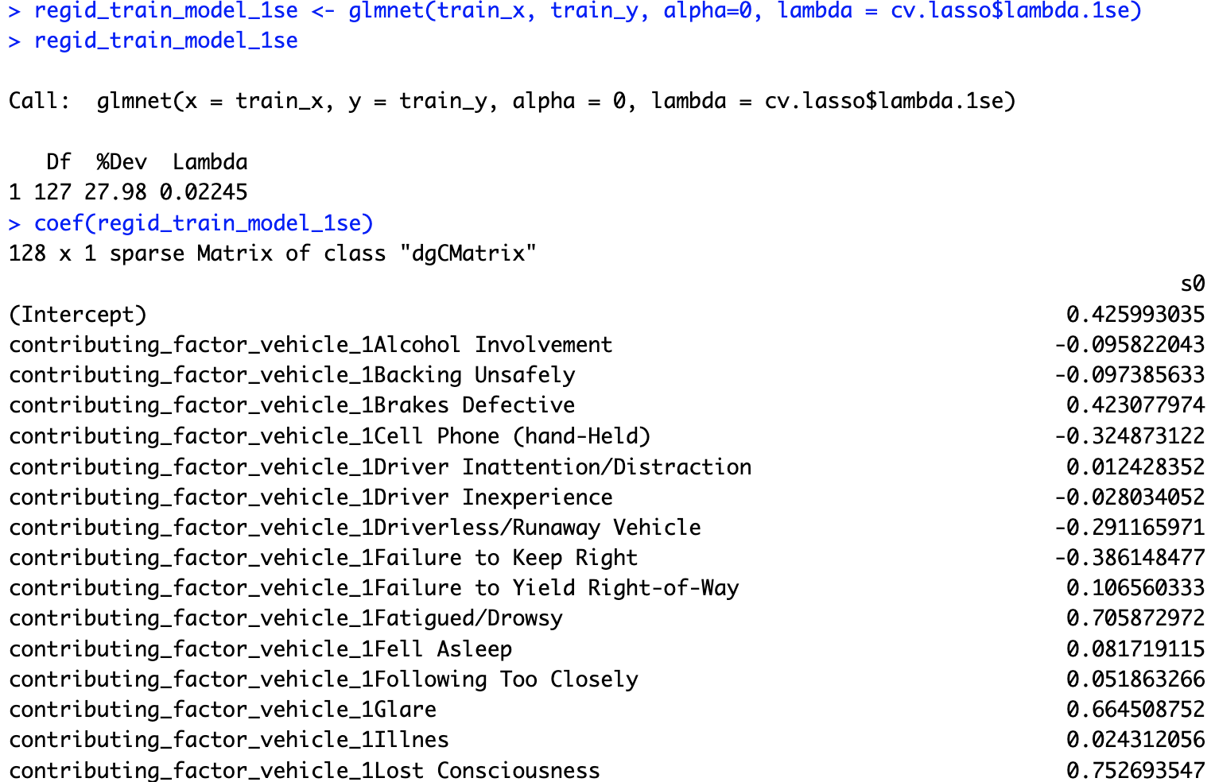
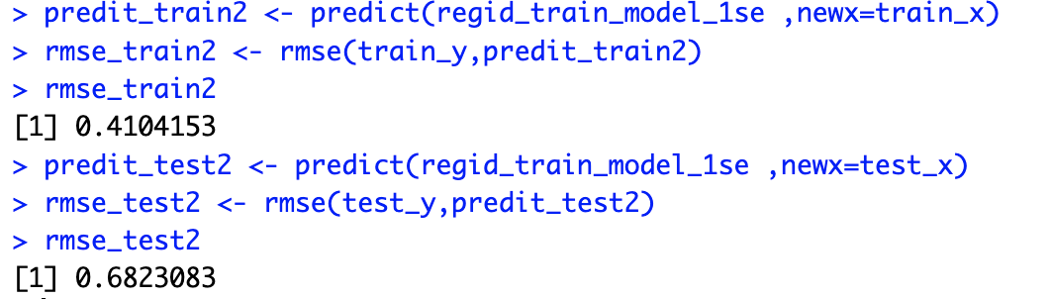
Ridge

Slide 12
Conclusion
Our regression analysis revealed that approximately 95% of the variance in the number of persons injured can be explained, with statistically significant positive associations found between injury severity and factors such as the number of pedestrians, cyclists, and motorists injured.
Employing a Generalized Linear Model (GLM) regression, we discovered that factors related to vehicles' contributing factors have a significant influence on the likelihood of fatalities. While our model displayed moderate accuracy, with an overall accuracy rate of 65.65% and a Kappa value of 0.1993 indicating fair agreement beyond random chance, there remains room for enhancement in sensitivity, as 32.00% of positive instances were correctly identified. Additional metrics such as recall, precision, and F1 score provided further insights into the model's performance, highlighting the delicate balance between correctly identifying fatalities and avoiding false positives. The GLM regression model achieved an AUC value of approximately 0.6465, signifying moderate discriminatory ability.
Furthermore, we explored the utilization of Ridge and Lasso regression models on a subset of the dataset. Both models offered valuable insights, with the Ridge model slightly outperforming the Lasso model on the test set. Hyperparameter tuning using cross-validation enabled us to pinpoint optimal lambda values for the Lasso model, resulting in enhanced predictive performance

Slide 13
Recommendations
Based on our analysis, several recommendations can be made to improve road safety and mitigate the severity of injuries and fatalities in motor vehicle collisions
Targeted Educational Campaigns
Law Enforcement Prioritization
Infrastructure Improvements
Medical Screening for Drivers
Technology Integration
Regular Monitoring and Evaluation

Slide 14
Thankyou
References:
Motor Vehicle Collisions - Crashes. (n.d.):[online]; https://www.kaggle.com/datasets/tush32/motor-vehicle-collisions-crashes/data NEU: Regularization; [online]: https://northeastern.instructure.com/courses/174682/assignments/2098624
Since.smith: Ridge Regression and the Lasso; [online]: Lab 10 - Ridge Regression and the Lasso in R (smith.edu)
Trevor Hastie, Junyang Qian, Kenneth Tay; (27 March 2023): An Introduction to glmnet; [online]: An Introduction to `glmnet` • glmnet (stanford.edu)
Dr Simonj (10 April 2017): How and when: ridge regression with glmnet; [online]: How and when: ridge regression with glmnet (svbtle.com)
Datacamp (November 2019): Regularization in R Tutorial: Ridge, Lasso and Elastic Net; [online]: Regularization in R Tutorial: Ridge, Lasso & Elastic Net Regression | DataCamp
University of Sidney: Lasso Regression; [online]: 4 Lasso Regression | Machine Learning for Biostatistics (bookdown.org)
Jose M Sallan (17 June 2022): Regularized regression with glmnet; [online]: Regularized regression with glmnet - Jose M Sallan blog (jmsallan.netlify.app)
Kassambara (3 November 2018): Penalized Logistic Regression Essentials in R: Ridge, Lasso and Elastic Net; [online]: Penalized Logistic Regression Essentials in R: Ridge, Lasso and Elastic Net - Articles - STHDA

